Slide 1
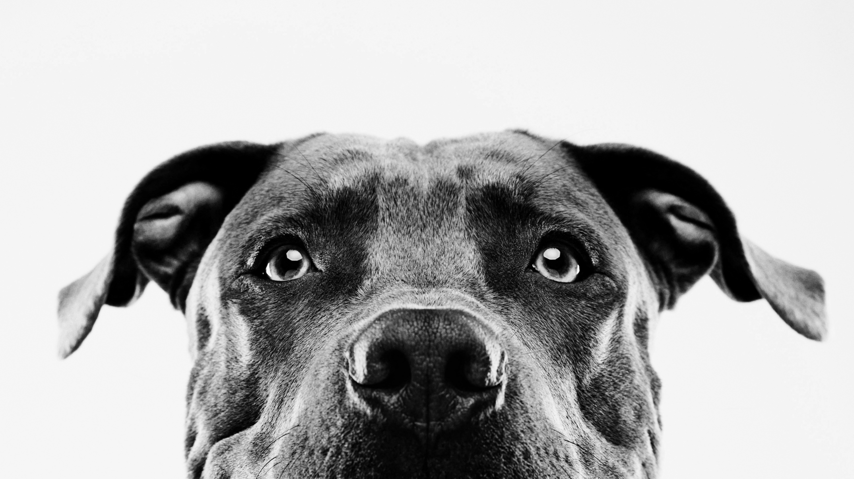
GET a pet
BY:
- Himanshu (1268)
- Gaurav (1291)
- shashank (1295)

Slide 2
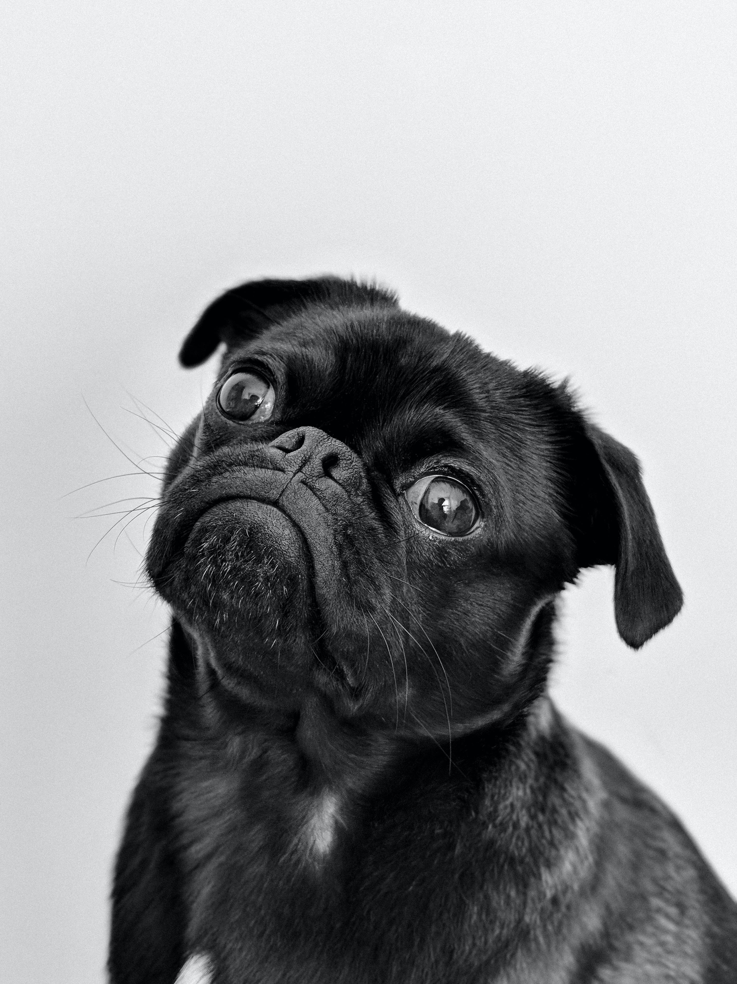
IDEA:
Animal Welfare: we aim to provide homeless pets with a chance for a better life by connecting them with caring individuals or families who can provide them with love, care, and a forever home.
Responsible Pet Ownership: The site serves as a means to encourage responsible pet ownership and commitment involved in caring for a pet.
Social Good and Contribution: WE address a societal issue - the plight of homeless animals - and providing a solution that benefits both animals and humans.

Slide 3
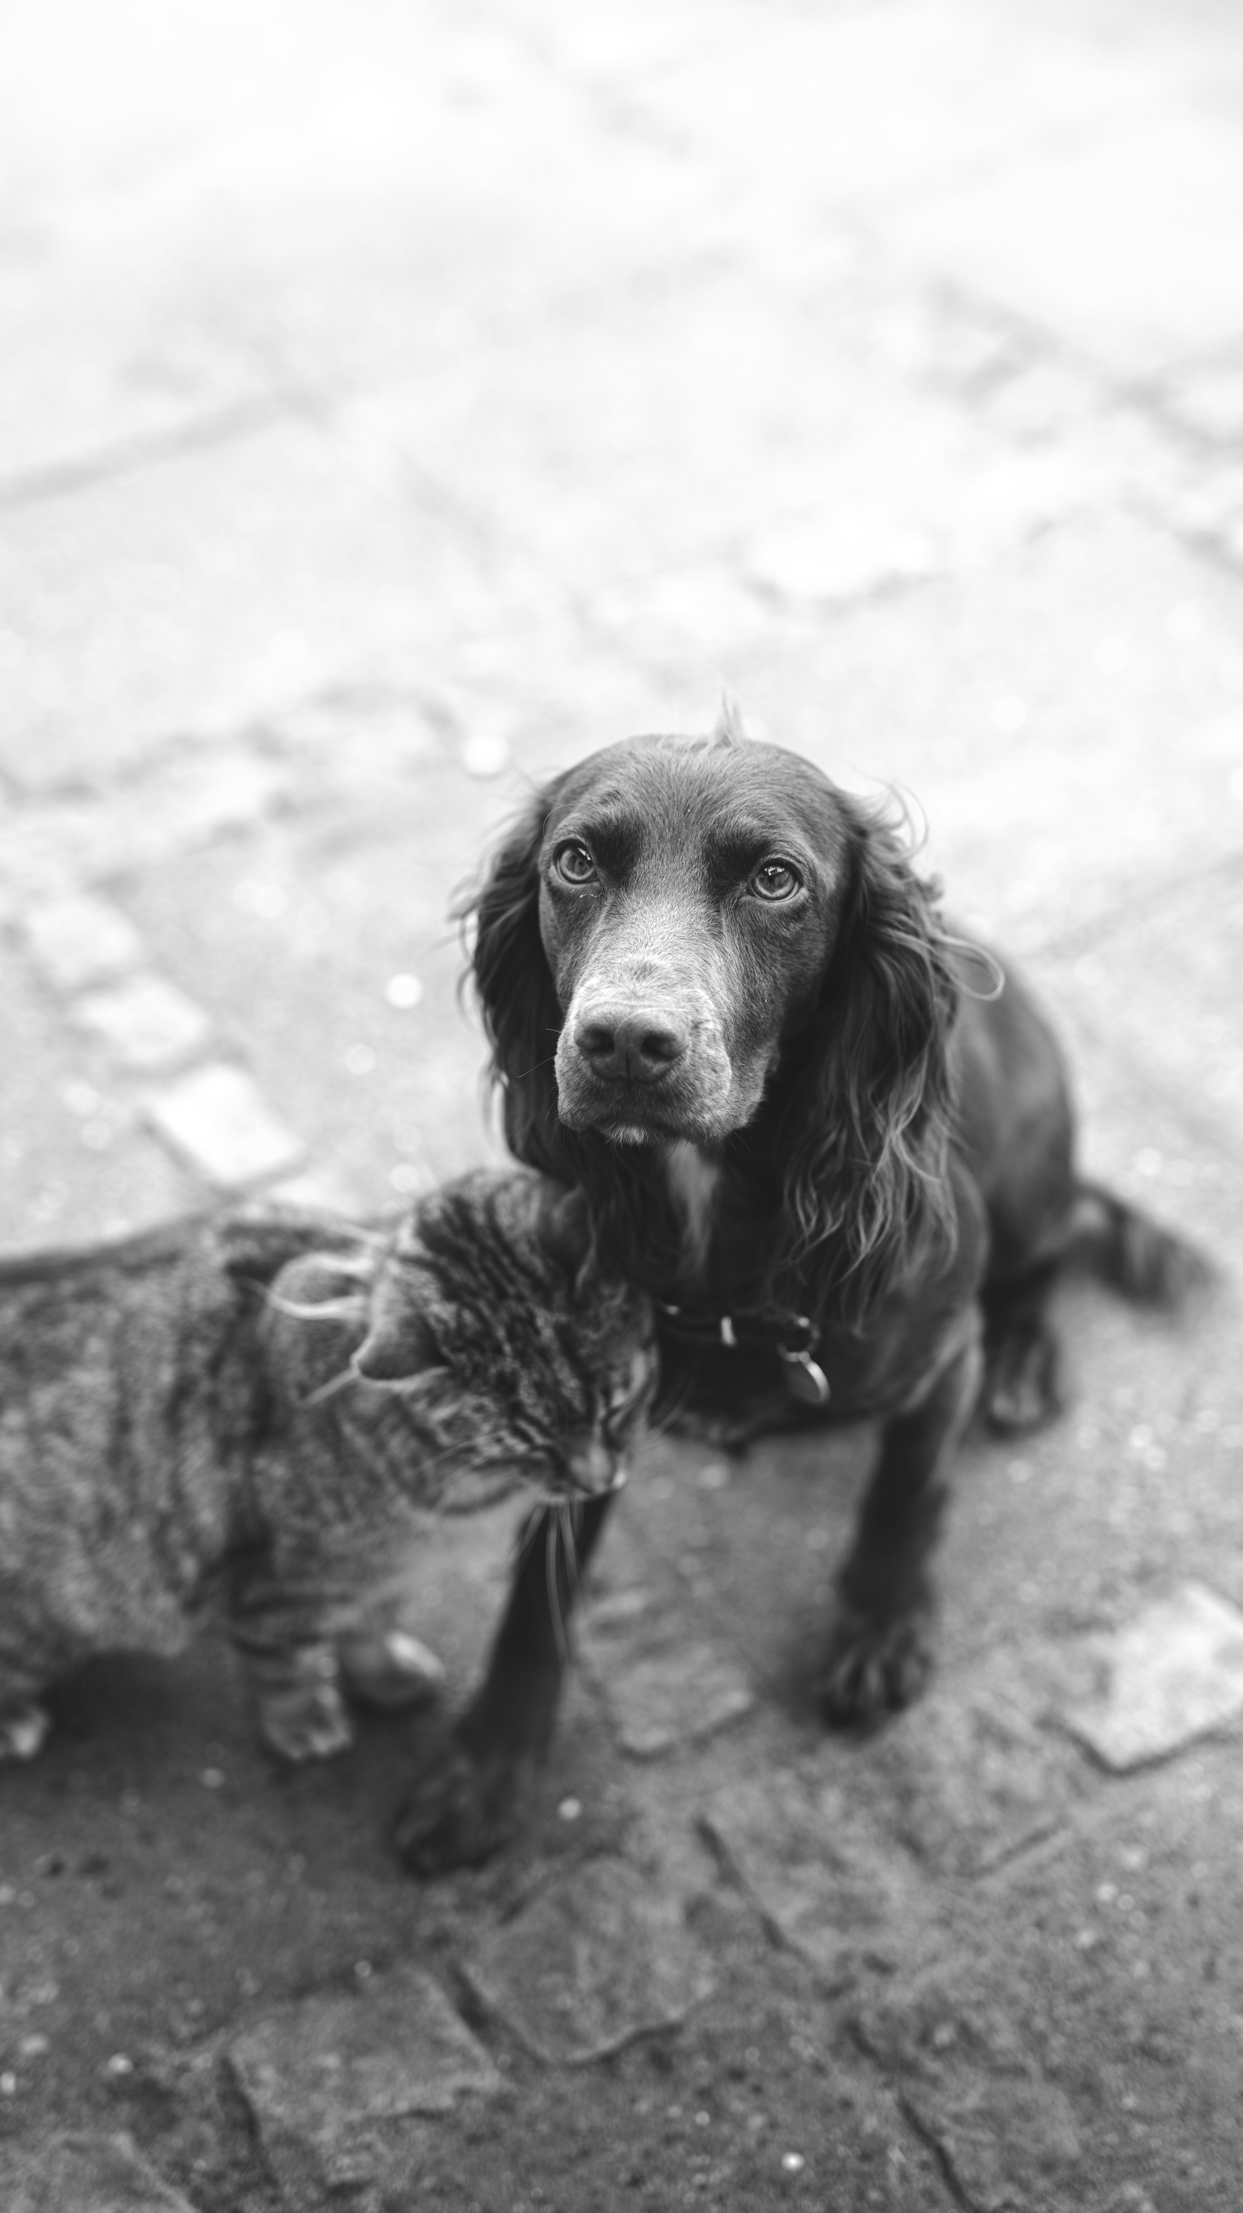
CONCEPT:
Pet Adoption Listings: Display available pets for adoption with detailed profiles including images, descriptions, breed information, age, and health status.
Adoption Application Process: Facilitate an easy-to- follow adoption process with online application, Enabling users to submit applications to adopt pets directly through the website.
TECHNOLOGIES USED: React JS, CSS, bootstrap, NODE JS, MYSQL, express.

Slide 4
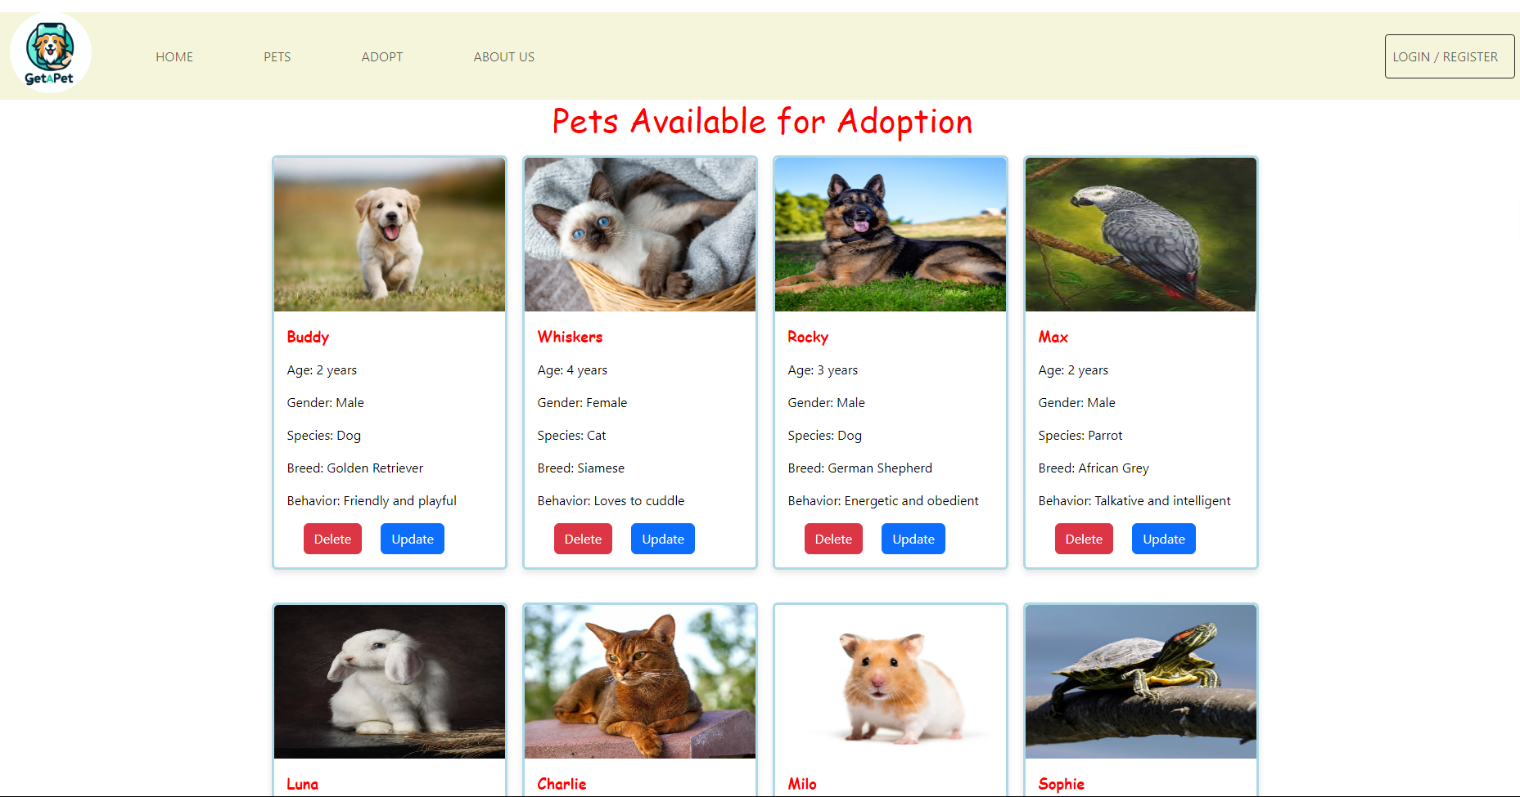
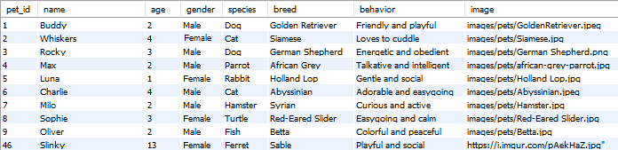
SOME GLIMPSES

Slide 5
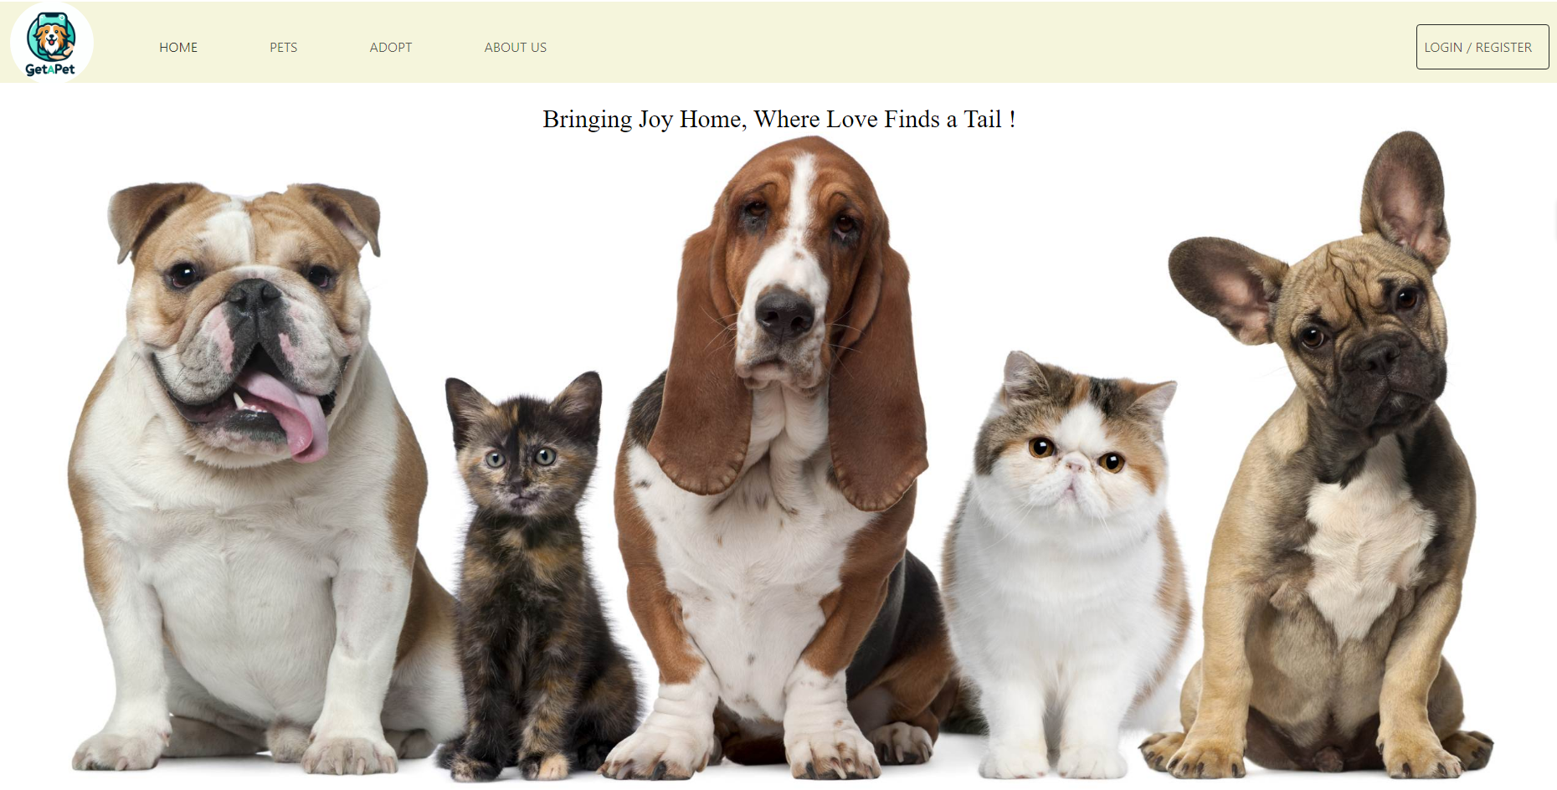
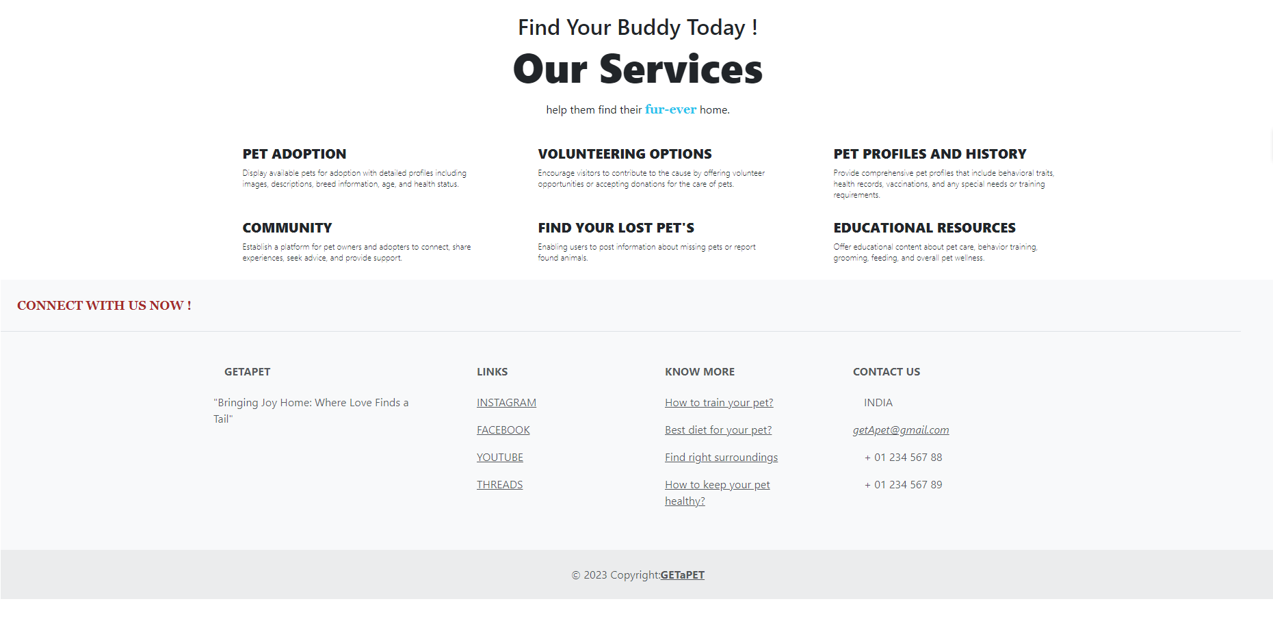

Slide 6
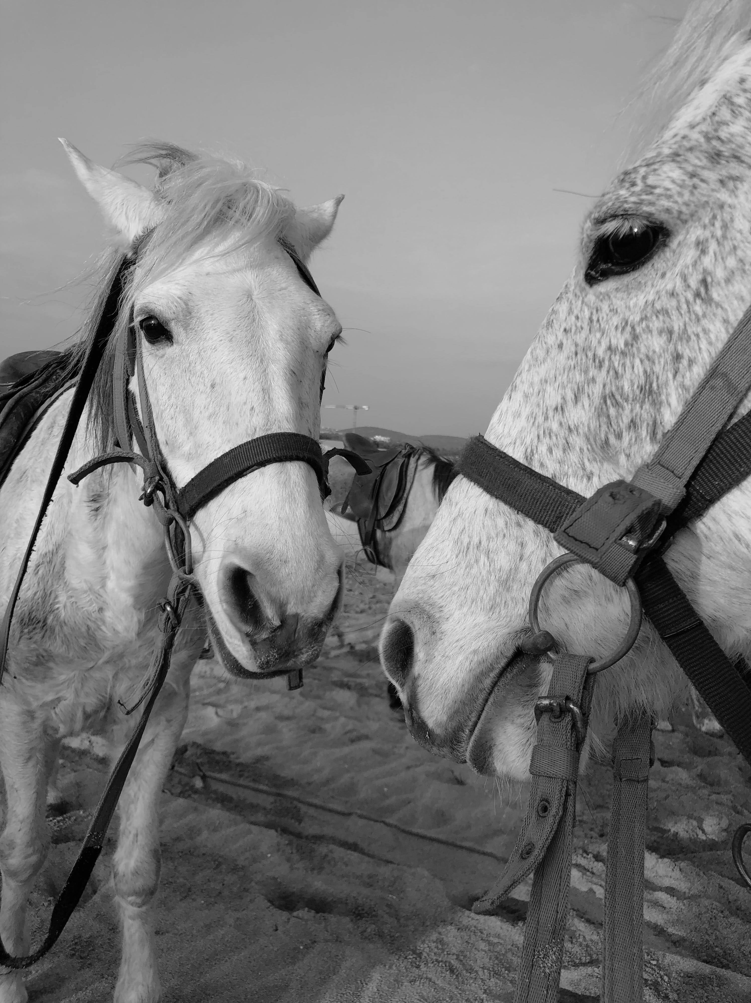
Drawbacks:
Separating admin and user databases.
Applying filter to sort pets to display on front end.
Adding educational resources.
More Animations, css are to be added.
User registration connection with back end.

Slide 7
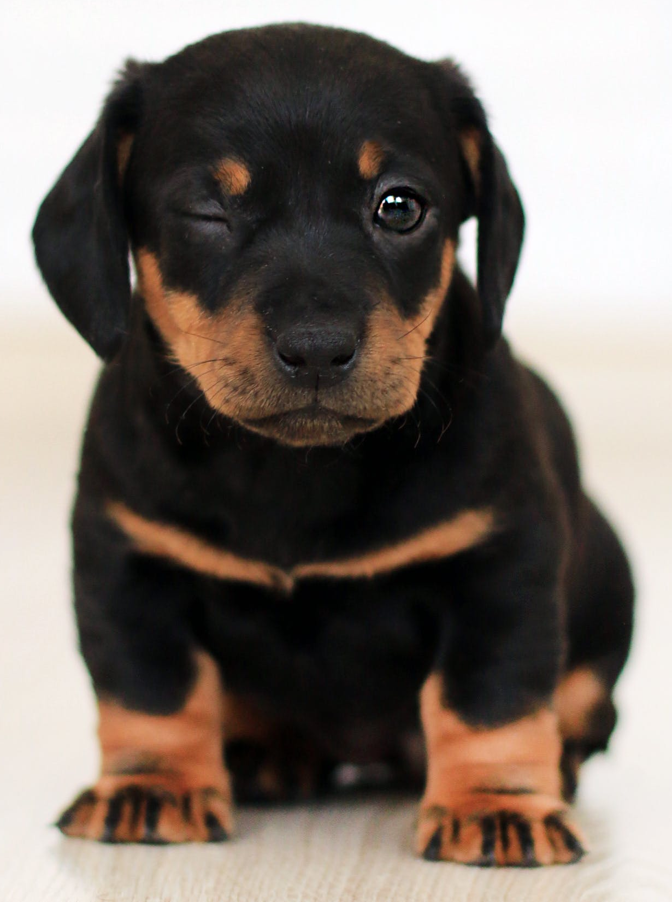
THANK YOU !

